Slide 1

Case Studies
Experiencing Cluster Computing
Class 7

Slide 2
Case 1:
Number Guesser

Slide 3

Number Guesser
2 players game ~ Thinker & Guesser
Thinker thinks of a number between 1 & 100
Guesser guesses
Thinker tells the guesser whether guess is high, low or correct
Guesser’s best strategy
  Remember high and low guesses
  Guess the number in between
  If guess was high, reset remembered high guess to guess
  If guess was low, reset remembered low guess to guess
➔ 2 processes
Source
http://www.sci.hkbu.edu.hk/tdgc/tutorial/ExpClusterComp/guess.c

Slide 4
Number Guesser
Reply char
Thinker
Guesser
Guess int
Processor 0
Processor 1

Slide 5
Thinker
#include <stdio.h>
#include <mpi.h>
#include <time.h>
thinker()
{
int number,guess;
char reply = ‘x’;
MPI_Status status;
srand(clock());
number = rand()%100+1;
printf("0: (I'm thinking of %d)\n",number);
while(reply!='c') {
MPI_Recv(&guess,1,MPI_INT,1,0,MPI_COMM_WORLD,&status);
printf("0: 1 guessed %d\n",guess);
if(guess==number)reply = 'c';
else
if(guess>number)reply = 'h';
else reply = 'l';
MPI_Send(&reply,1,MPI_CHAR,1,0, MPI_COMM_WORLD);
printf("0: I responded %c\n",reply);
}
}

Slide 6
Thinker (processor 0)
clock() returns time in CLOCKS_PER_SEC since process started
srand() seeds random number generator
rand() returns next random number
MPI_Recv receives in guess one int from processor 1
MPI_Send sends from reply one char to processor 1

Slide 7
Guesser
guesser()
{
char reply;
MPI_Status status;
int guess,high,low;
srand(clock());
low = 1;
high = 100;
guess = rand()%100+1;
while(1)
{
MPI_Send(&guess,1,MPI_INT,0,0,MPI_COMM_WORLD);
printf("1: I guessed %d\n",guess);
MPI_Recv(&reply,1,MPI_CHAR,0,0,MPI_COMM_WORLD,&status);
printf("1: 0 replied %c\n",reply);
switch(reply)
{
case 'c': return;
case 'h': high = guess;
break;
case 'l': low = guess;
break;
}
guess = (high+low)/2;
}
}

Slide 8
Guesser (processor 1)
MPI_Send sends from guess one int to processor 0
MPI_Recv receives in reply one char from processor 0

Slide 9
main
main(argc,argv)
int argc;
char ** argv;
{
int id,p;
MPI_Init(&argc,&argv);
MPI_Comm_rank(MPI_COMM_WORLD,&id);
if(id==0)
thinker();
else
guesser();
MPI_Finalize();
}

Slide 10
Number Guesser
Process 0 is thinker & Process 1 is guesser
  % mpicc –O –o guess guess.c
  % mpirun –np 2 guess
Output:
  0: (I'm thinking of 59)
  0: 1 guessed 46
  0: I responded l
  0: 1 guessed 73
  0: I responded h
  0: 1 guessed 59
  0: I responded c
  1: I guessed 46
  1: 0 replied l
  1: I guessed 73
  1: 0 replied h
  1: I guessed 59
  1: 0 replied c

Slide 11
Case 2: Parallel Sort

Slide 12
Parallel Sort
Sort a file of n integers on p processors
Generate a sequence of random numbers
Pad the numbers and make its length a multiple of p
  n+p-n%p
Scatter sequences of n/p+1 to the p processors
Sort the scattered sequences in parallel on each processor
Merge sorted sequences from neighbors in parallel
  log₂ p steps are needed

Slide 13
Parallel Sort
Scatter
Proc 0
Proc 1
Proc 2
…
Proc p - 1
Merge
1st
Proc 0
Proc 1
Proc 2
Proc 3
Proc 4
2nd
Proc 0
Proc 1
Proc 2
Proc 3
Proc 4
3rd
Proc 0
Proc 1
Proc 2
Proc 3
Proc 4

Slide 14
Parallel Sort
e.g. Sort 125 integers with 8 processors
Pad: 125+8-125%8 = 125+8-5 = 125+3 = 128
Scatter: 16 integers on each proc 0 – proc 7
Sorting: each proc sorts its 16 integers.
Merge (1st step):
16 from P0 & 16 from P1 → P0 == 32
16 from P2 & 16 from P3 → P2 == 32
16 from P4 & 16 from P5 → P4 == 32
16 from P6 & 16 from P7 → P6 == 32
Merge (2nd step):
  32 from P0 & 32 from P2 → P0 == 64
  32 from P4 & 32 from P6 → P4 == 64
Merge (3rd step):
  64 from P0 & 64 from P4 → P0 == 128

Slide 15
Algorithm
Root
  Generate a sequence of random numbers
  Pads data to make size a multiple of number of processors
  Scatters data to all processors
  Sorts one sequence of data
Other processes
  receive & sort one sequence of data
Sequential Sorting Algorithm:
Quick sort, bubble sort, merge sort, heap sort, selection sort, etc

Slide 16
Algorithm
Each processor is either a merger or sender of data
Keep track of distance (step) between merger and sender on each iteration
  double step each time
Merger rank must be a multiple of 2*step
Sender rank must be merger rank + step
If no sender of that rank then potential merger does nothing
Otherwise must be a sender
  send data to merger on left
    at sender rank - step
  terminate
Finished, root print out the result

Slide 17
Example Output
$ mpirun -np 5 qsort
0 about to broadcast 20000
0 about to scatter
0 sorts 20000
1 sorts 20000
2 sorts 20000
3 sorts 20000
4 sorts 20000
step 1: 1 sends 20000 to 0
step 1: 0 gets 20000 from 1
step 1: 0 now has 40000
step 1: 3 sends 20000 to 2
step 1: 2 gets 20000 from 3
step 1: 2 now has 40000
step 2: 2 sends 40000 to 0
step 2: 0 gets 40000 from 2
step 2: 0 now has 80000
step 4: 4 sends 20000 to 0
step 4: 0 gets 20000 from 4
step 4: 0 now has 100000

Slide 18
Quick Sort
The quick sort is an in-place, divide-and-conquer, massively recursive sort.
Divide and Conquer Algorithms
  Algorithms that solve (conquer) problems by dividing them into smaller sub-problems until the problem is so small that it is trivially solved.
In Place
  In place sorting algorithms don't require additional temporary space to store elements as they sort; they use the space originally occupied by the elements.
Reference
  http://ciips.ee.uwa.edu.au/~morris/Year2/PLDS210/qsort.html
Source
  http://www.sci.hkbu.edu.hk/tdgc/tutorial/ExpClusterComp/qsort/qsort.c

Slide 19
Quick Sort
The recursive algorithm consists of four steps (which closely resemble the merge sort):
  If there are one or less elements in the array to be sorted, return immediately.
  Pick an element in the array to serve as a "pivot" point. (Usually the left-most element in the array is used.)
  Split the array into two parts - one with elements larger than the pivot and the other with elements smaller than the pivot.
  Recursively repeat the algorithm for both halves of the original array.

Slide 20
Quick Sort
The efficiency of the algorithm is majorly impacted by which element is chosen as the pivot point.
The worst-case efficiency of the quick sort, O(n²), occurs when the list is sorted and the left-most element is chosen.
If the data to be sorted isn't random, randomly choosing a pivot point is recommended. As long as the pivot point is chosen randomly, the quick sort has an algorithmic complexity of O(n log n).
Pros: Extremely fast.
Cons: Very complex algorithm, massively recursive.

Slide 21
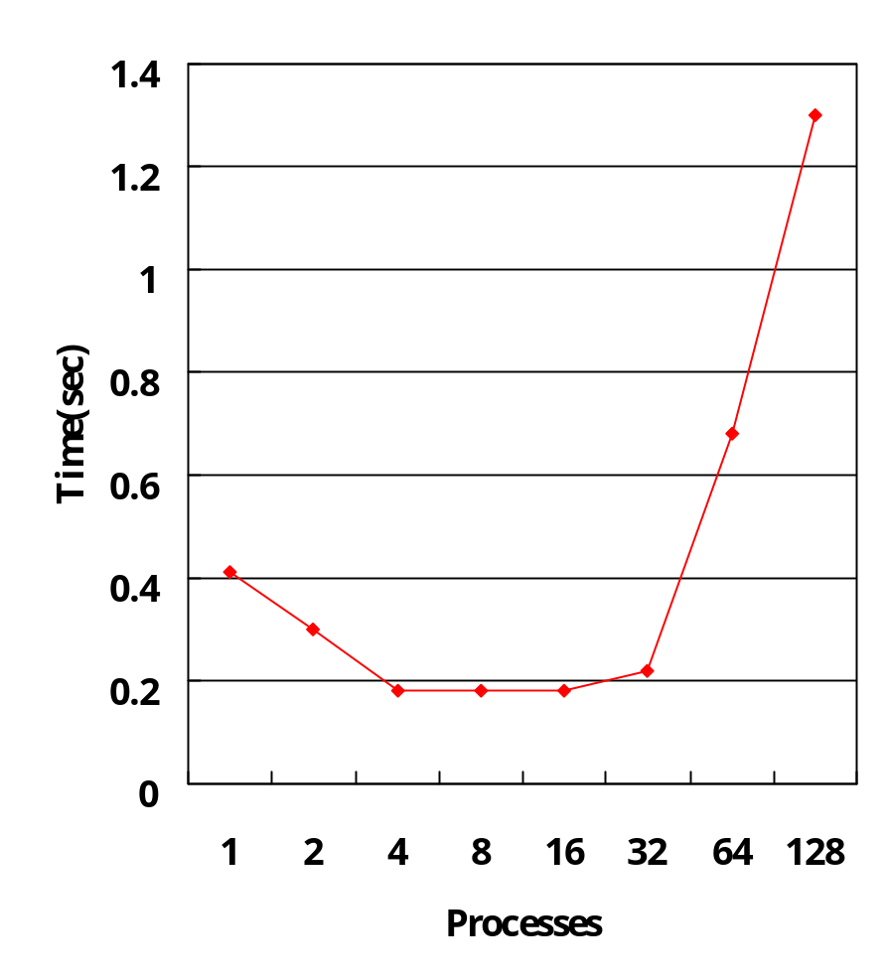
Quick Sort Performance
Processes | Time
1 | 0.410000
2 | 0.300000
4 | 0.180000
8 | 0.180000
16 | 0.180000
32 | 0.220000
64 | 0.680000
128 | 1.300000

Slide 22
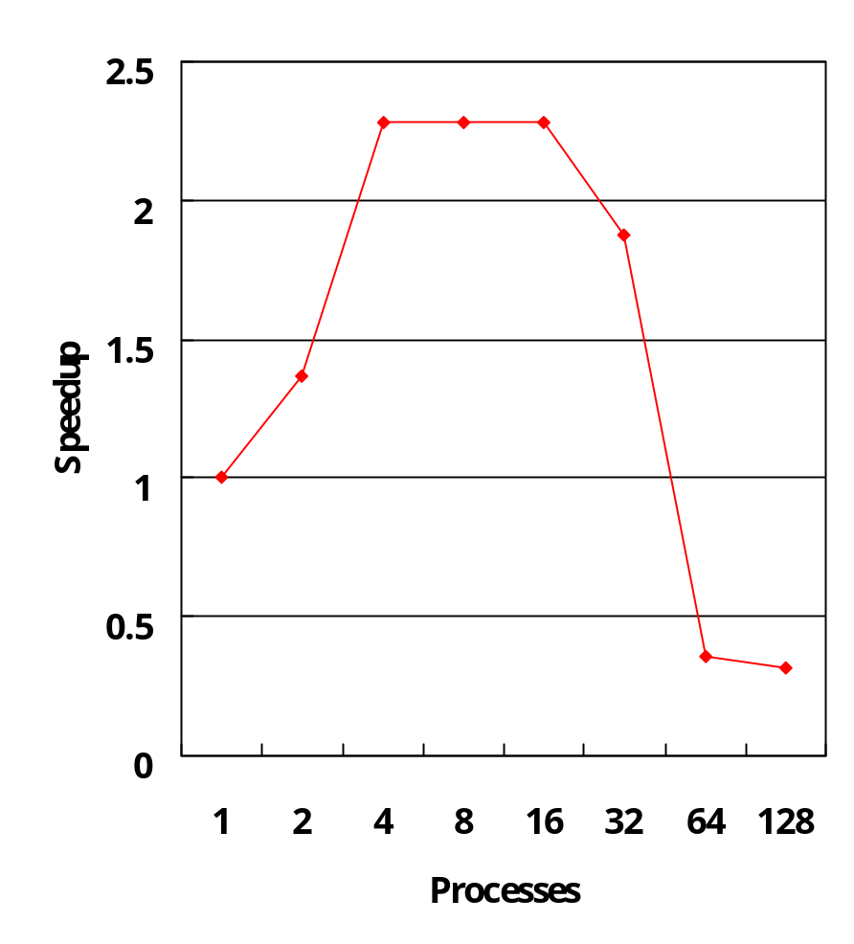
Quick Sort Speedup
Processes | Speedup
1 | 1
2 | 1.3667
4 | 2.2778
8 | 2.2778
16 | 2.2778
32 | 1.8736
64 | 0.6029
128 | 0.3154

Slide 23
Discussion
Quicksort takes time proportional to N*N for N data items
  for 1,000,000 items, Nlog₂N ~ 1,000,000*20
Constant communication cost – 2*N data items
  for 1,000,000 must send/receive 2*1,000,000 from/to root
In general, processing/communication proportional to N*log₂N/2*N = log₂N/2
  so for 1,000,000 items, only 20/2 =10 times as much processing as communication
Suggests can only get speedup, with this parallelization, for very large N

Slide 24
Bubble Sort
The bubble sort is the oldest and simplest sort in use. Unfortunately, it's also the slowest.
The bubble sort works by comparing each item in the list with the item next to it, and swapping them if required.
The algorithm repeats this process until it makes a pass all the way through the list without swapping any items (in other words, all items are in the correct order).
This causes larger values to "bubble" to the end of the list while smaller values "sink" towards the beginning of the list.

Slide 25
Bubble Sort
The bubble sort is generally considered to be the most inefficient sorting algorithm in common usage. Under best-case conditions (the list is already sorted), the bubble sort can approach a constant O(n) level of complexity. General-case is O(n²).
Pros: Simplicity and ease of implementation.
Cons: Horribly inefficient.
Reference
  http://math.hws.edu/TMCM/java/xSortLab/
Source
  http://www.sci.hkbu.edu.hk/tdgc/tutorial/ExpClusterComp/sorting/bubblesort.c

Slide 26
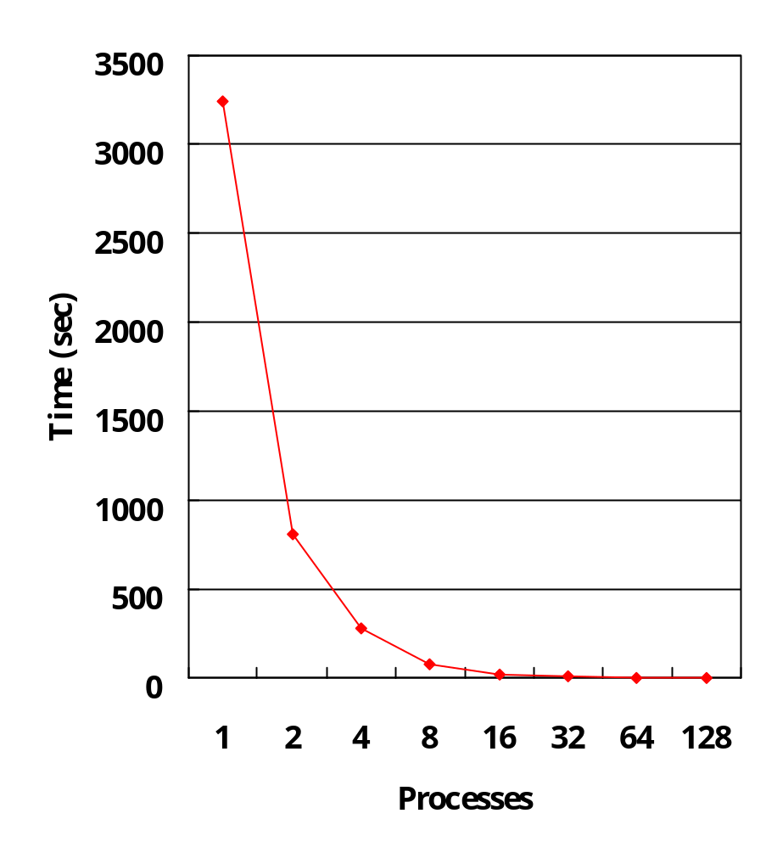
Bubble Sort Performance
Processes | Time
1 | 3242.327
2 | 806.346
4 | 276.4646
8 | 78.45156
16 | 21.031
32 | 4.8478
64 | 2.03676
128 | 1.240197

Slide 27
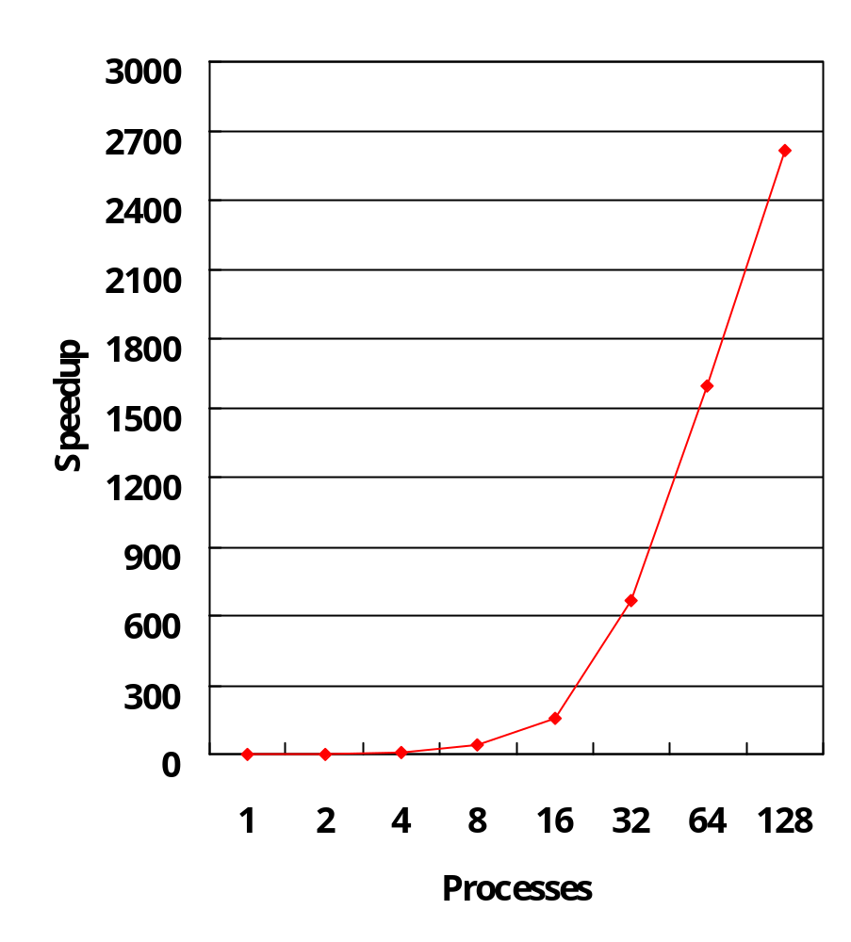
Bubble Sort Speedup
Processes | Speedup
1 | 1
2 | 4.021012
4 | 11.72782
8 | 41.32903
16 | 154.1689
32 | 668.8244
64 | 1591.904
128 | 2614.364

Slide 28
Discussion
Bubble sort takes time proportional to N*N/2 for N data items
This parallelization splits N data items into N/P so time on one of the P processors now proportional to (N/P*N/P)/2
  i.e. have reduced time by a factor of P*P!
Bubble sort is much slower than quick sort!
  better to run quick sort on single processor than bubble sort on many processors!

Slide 29
Merge Sort
The merge sort splits the list to be sorted into two equal halves, and places them in separate arrays.
Each array is recursively sorted, and then merged back together to form the final sorted list.
Like most recursive sorts, the merge sort has an algorithmic complexity of O(n log n).
Elementary implementations of the merge sort make use of three arrays - one for each half of the data set and one to store the sorted list in. The below algorithm merges the arrays in-place, so only two arrays are required. There are non-recursive versions of the merge sort, but they don't yield any significant performance enhancement over the recursive algorithm on most machines.

Slide 30
Merge Sort
Pros: Marginally faster than the heap sort for larger sets.
Cons: At least twice the memory requirements of the other sorts; recursive.
Reference
http://math.hws.edu/TMCM/java/xSortLab/
Source
http://www.sci.hkbu.edu.hk/tdgc/tutorial/ExpClusterComp/sorting/mergesort.c

Slide 31
Heap Sort
The heap sort is the slowest of the O(n log n) sorting algorithms, but unlike the merge and quick sorts it doesn't require massive recursion or multiple arrays to work. This makes it the most attractive option for very large data sets of millions of items.
The heap sort works as it name suggests
  It begins by building a heap out of the data set,
  Then removing the largest item and placing it at the end of the sorted array.
  After removing the largest item, it reconstructs the heap and removes the largest remaining item and places it in the next open position from the end of the sorted array.
  This is repeated until there are no items left in the heap and the sorted array is full. Elementary implementations require two arrays - one to hold the heap and the other to hold the sorted elements.

Slide 32
Heap Sort
To do an in-place sort and save the space the second array would require, the algorithm below "cheats" by using the same array to store both the heap and the sorted array. Whenever an item is removed from the heap, it frees up a space at the end of the array that the removed item can be placed in.
Pros: In-place and non-recursive, making it a good choice for extremely large data sets.
Cons: Slower than the merge and quick sorts.
Reference
  http://ciips.ee.uwa.edu.au/~morris/Year2/PLDS210/heapsort.html
Source
  http://www.sci.hkbu.edu.hk/tdgc/tutorial/ExpClusterComp/heapsort/heapsort.c

Slide 33
End

